Slide 1

Red Team Ops
A Beginners Guide to Red Team Operations

Slide 2
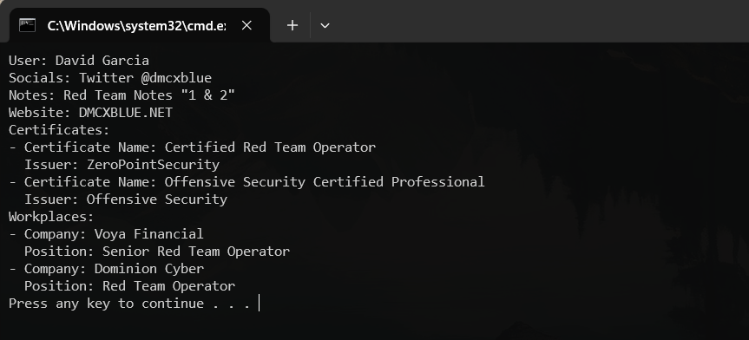
WHOAMI

Slide 3
What is a Red Team??
A good dictionary definition is provided by Joe Vest and James Tubberville:
Red Teaming is the process of using tactics, techniques and procedures (TTPs) to emulate a real-world threat, with the goal of measuring the effectiveness of the people, processes and technologies used to defend an environment

Slide 4
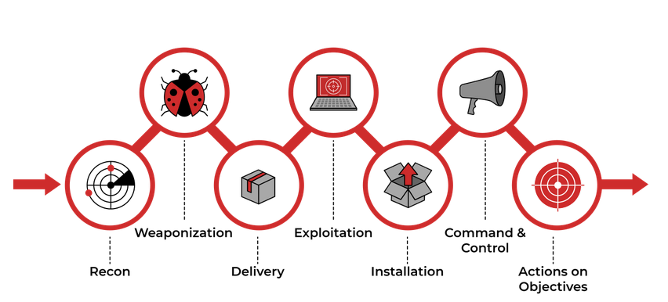
Cyber Kill Chain

Slide 5
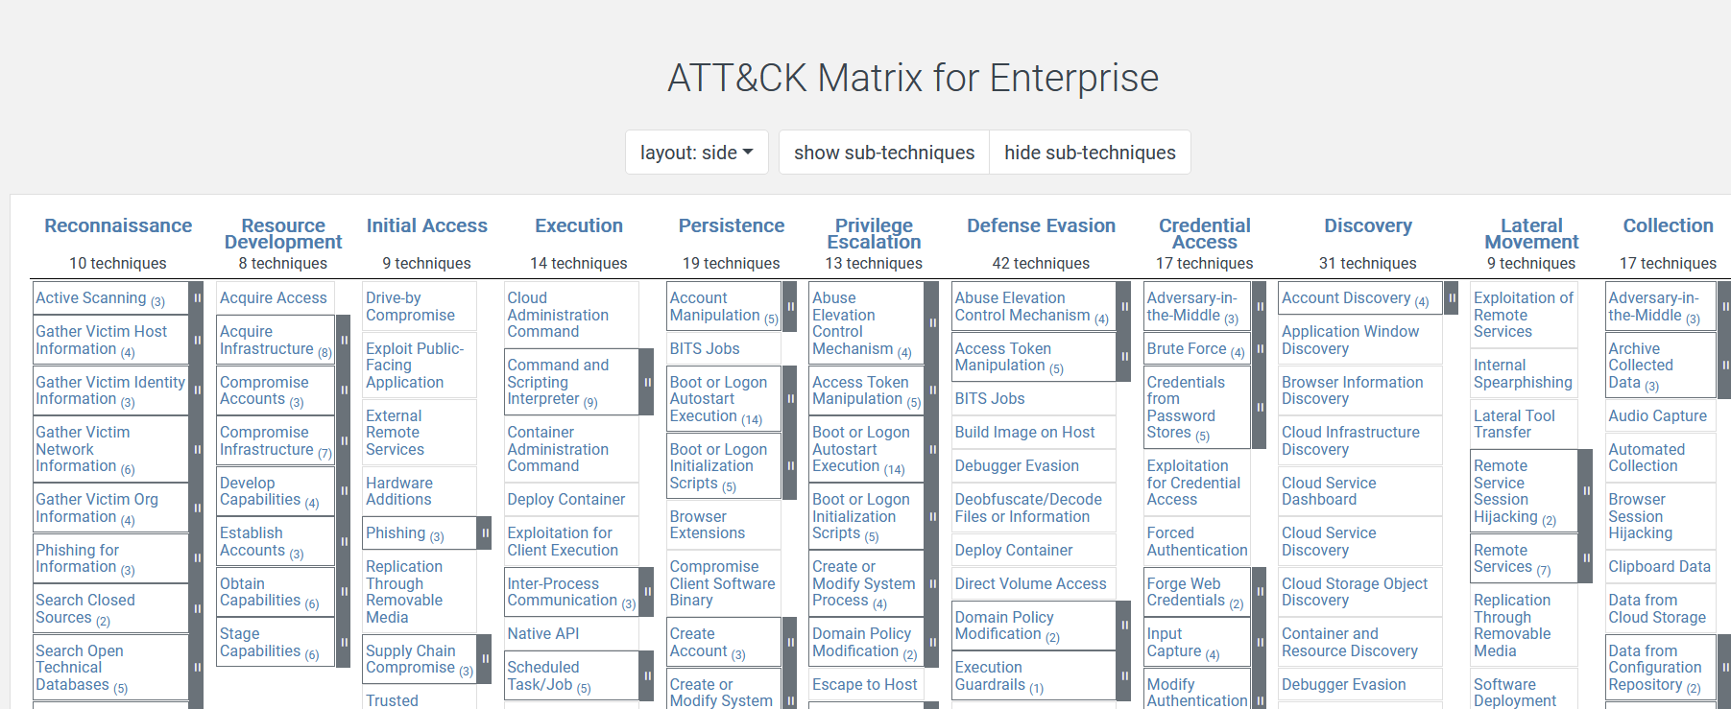
MITRE ATT&CK

Slide 6
Reconnaissance
Passive Reconnaissance
This type of reconnaissance is known as Open-Source Intelligence (OSINT).
Active Reconnaissance
Active reconnaissance is the opposite of passive reconnaissance and the process of gathering information by interacting with the target.
External Reconnaissance
External recon is anything that takes place outside the target’s network.
Internal Reconnaissance
Internal reconnaissance takes place within the target network.

Slide 7
External Enumeration

Slide 8
Passive
OSINT framework
Focused on gathering information from free tools or resources. The intention is to help people find free OSINT resources.
https://osintframework.com/
Inteltechniques
An amazing site where search tools are offered for Open Source Intelligence Gathering
https://inteltechniques.com/

Slide 9
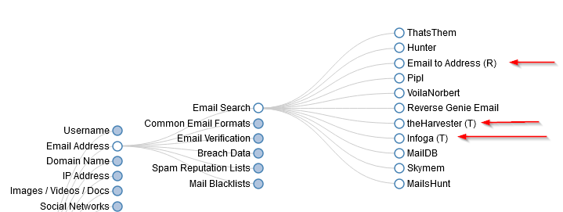
OSINT Framework

Slide 10
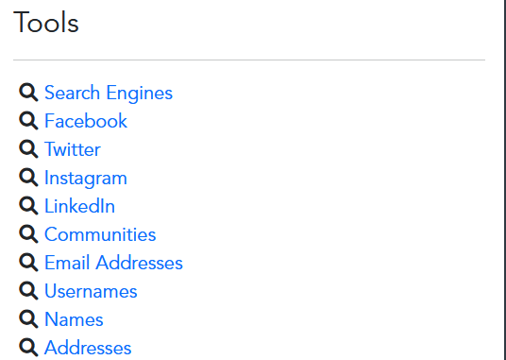
Intel Techniques

Slide 11
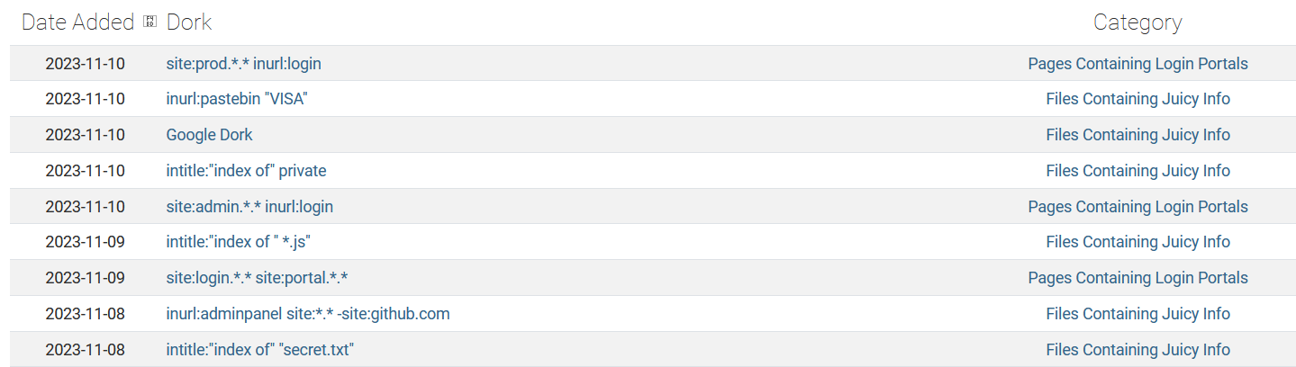
Google Dorking
The GHDB is an index of search queries used to find publicly available information, intended for pentesters and security researchers.

Slide 12
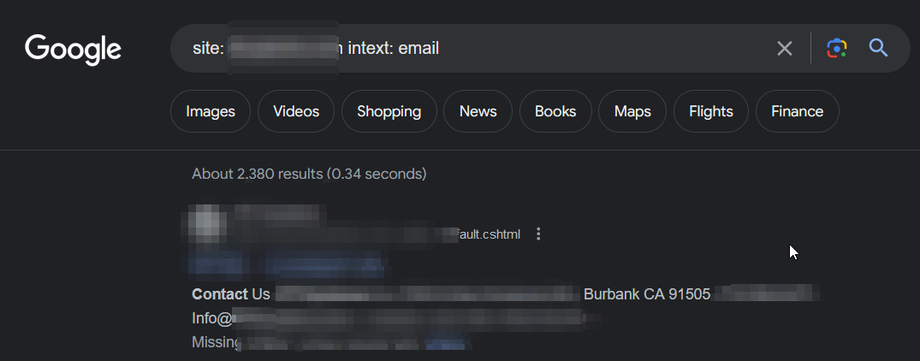
Not 100% accurate since Google tends to fix or hide this type of information when utilizing these queries, but you can still find valuable info

Slide 13
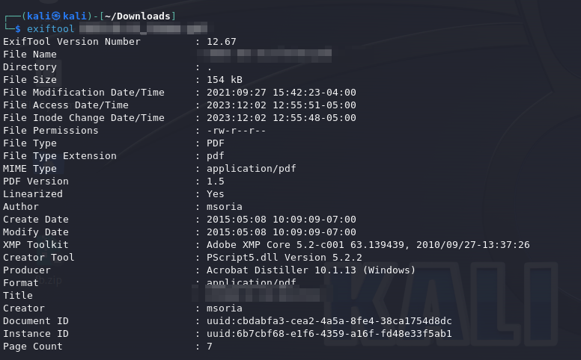
MetaData
“Data that provides information about other data"

Slide 14
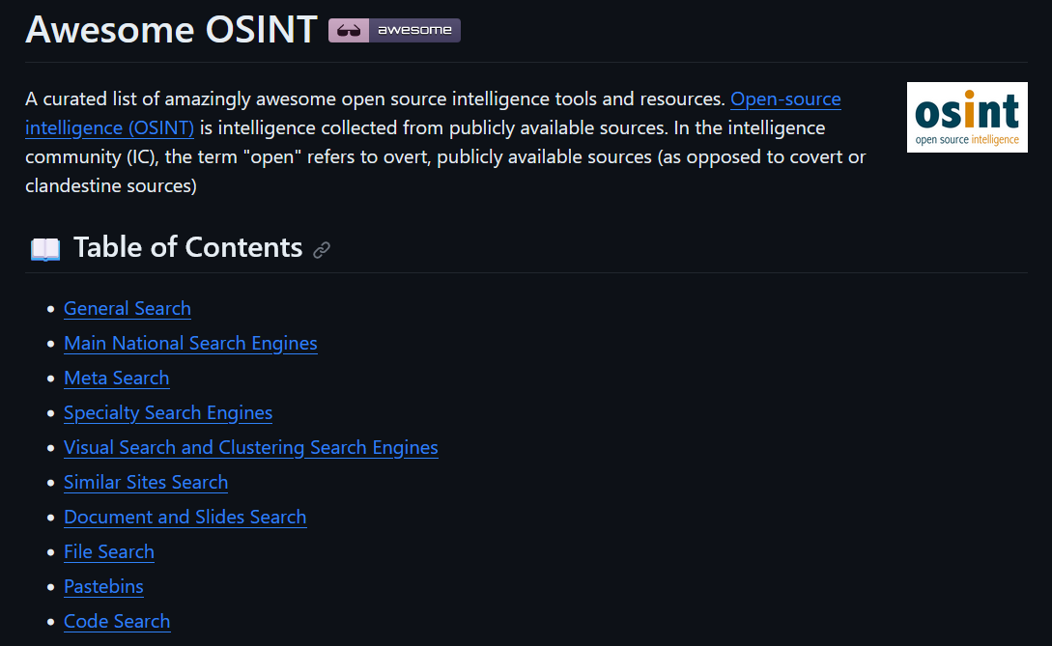
Do not stop there these tools are just the tip of the iceberg, search and explore more as tools with specific or general capabilities are out there.
https://github.com/jivoi/awesome-osint

Slide 15
Active
Nmap
Nmap is a network scanner created by Gordon Lyon. Nmap is used to discover hosts and services on a computer network by sending packets and analyzing the responses.
Nuclei
Nuclei is used to send requests across targets based on a template, leading to zero false positives and providing fast scanning on a large number of hosts. Nuclei offers scanning for a variety of protocols, including TCP, DNS, HTTP, SSL, File, Whois, Websocket, Headless etc.

Slide 16
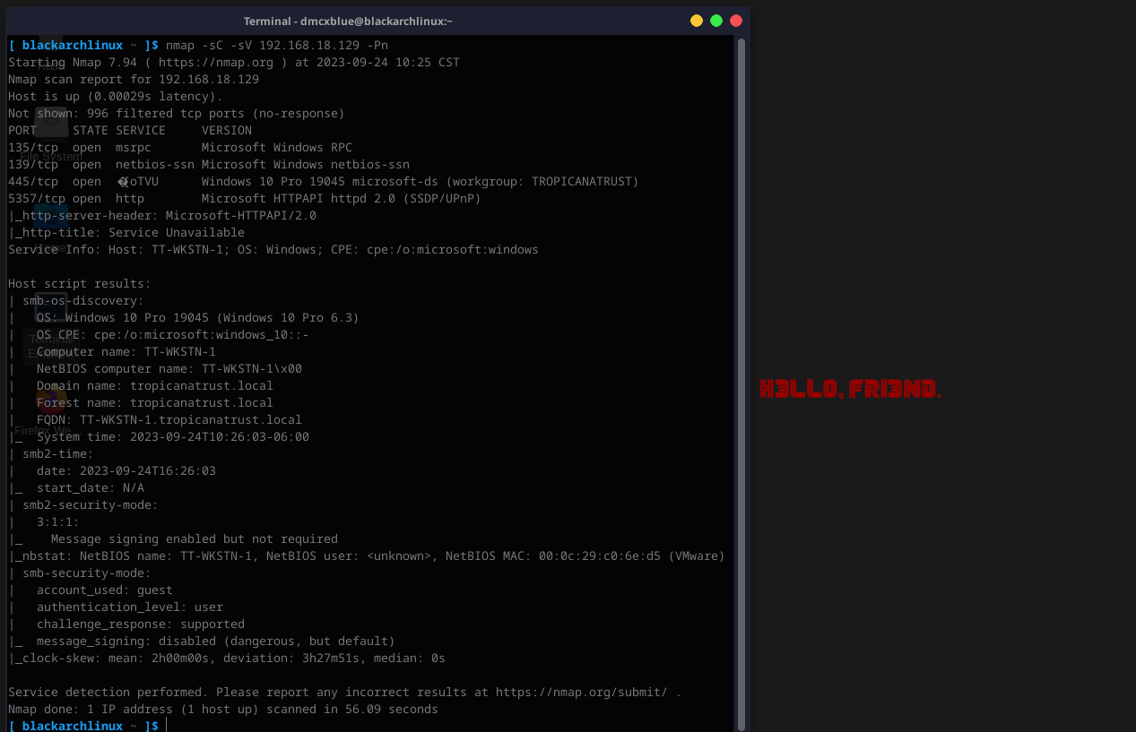
NMAP

Slide 17
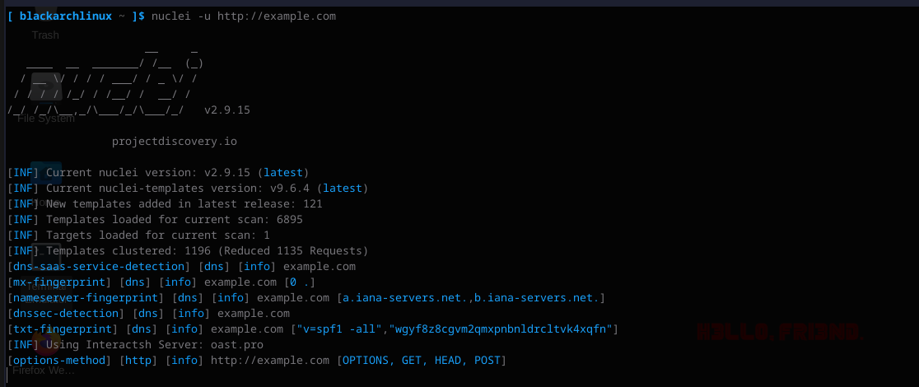
Nuclei

Slide 18
Exercise
Find the location in the photo
Extra: Find secret site with some old posts

Slide 19
Weaponization & Initial Access
Weaponization is the part of the engagement where the Red Teamer generates payloads to exploit the target
Examples:
HTA
MACROS
Jscript
CPL
And More…

Slide 20
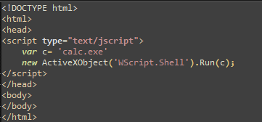
HTA
An HTML Application (HTA) is a Microsoft Windows program whose source consists of HTML, Dynamic HTML, and one or more scripting languages supported by Internet Explorer, such as VBScript or JScript.

Slide 21
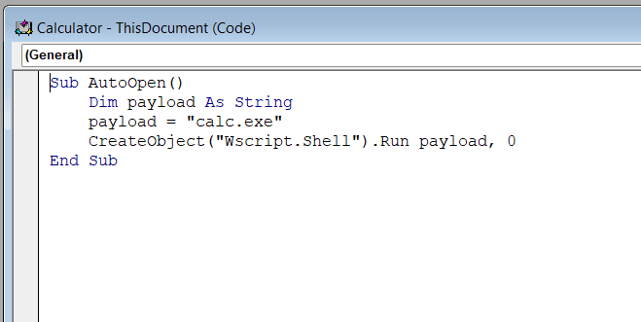
Macros (VBA)
Macros, they are series of commands and instructions that you group together as a single command to accomplish a task automatically. Macros are also popular since these can interact with the Windows API

Slide 22
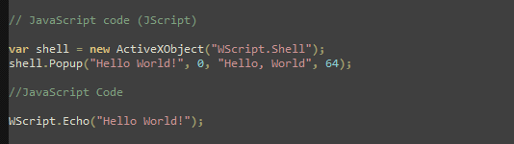
JScript
JScript is a scripting language developed by Microsoft. It is very similar to JavaScript, and in fact, JScript was Microsoft's implementation of JavaScript for their Internet Explorer web browser.

Slide 23
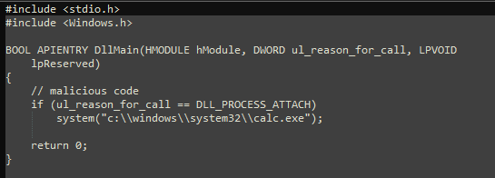
CPL
A CPL file is short for Control Panel File. These files are binary files that open with the control panel in a Microsoft Windows operating system and are used to represent and open the tools available in the control panel.
We can see that the .cpl is simply a DLL with DllMain function exported:

Slide 24
Password Spraying
Password spraying is a type of cyberattack that targets user accounts and online services, typically with the aim of gaining unauthorized access.
Unlike traditional brute-force attacks, where an attacker systematically tries every possible password for a single user account, password spraying involves trying a few commonly used passwords or a list of commonly used passwords across many user accounts.

Slide 25
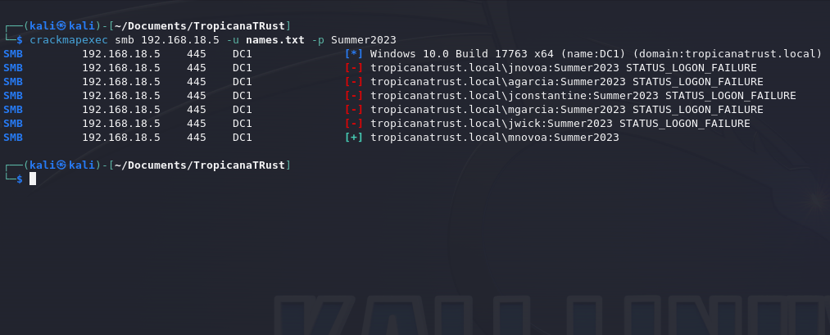

Slide 26
AV/EDR
Static Detection
Such as malicious strings (Mimikatz, Meterpreter, Shellcode)
Runtime Detection
When execution happens (What’s the payload doing?, Calling a Domain back?, Utilizing specific API’s?)
Behavior Detection
What’s the process doing?, Reading Files? Requesting Tickets, Suspicious Commands? (Whoami, Net User, ipconfig)

Slide 27
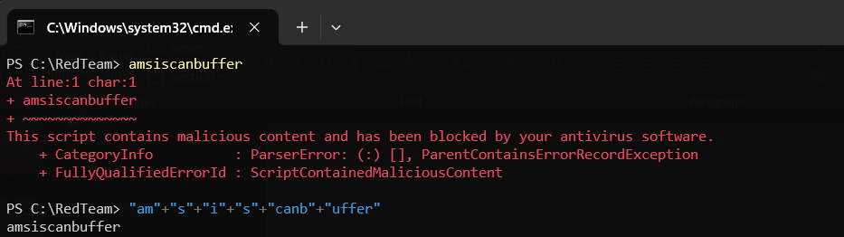
A simple demonstration on static detection, to understand how simple strings can burn our payloads

Slide 28
Mark Of The Web
"Mark of the Web" (MOTW) typically refers to a security feature in web browsers, particularly in Microsoft Windows operating systems. This feature is designed to enhance the security of users by identifying files that have been downloaded from the internet.
The Mark of the Web is essentially a tag or metadata that is attached to files downloaded from the web, indicating their origin.
Here's how it works:
Downloading Files from the Internet: When you download a file from the internet using a web browser on a Windows system, the browser adds the Mark of the Web to the file.
Security Zone Information: The Mark of the Web is part of the Security Zone Information for the file. Security zones are used to categorize websites based on their trustworthiness. For example, websites in the "Internet" zone are considered less trusted than those in the "Local Intranet" zone.

Slide 29
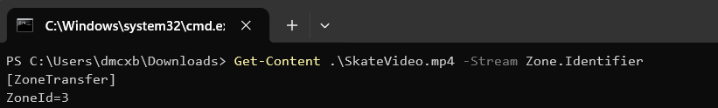

Slide 30
Delivery
How are payloads delivered?
Digital, Physical?
What are the types of digital forms of deliveries or services available
Facebook, Google Chat, Zoom, Instagram, Teams, LinkedIn
Phishing, Vishing, SMShing
Emails, Calls, Text Messages

Slide 31
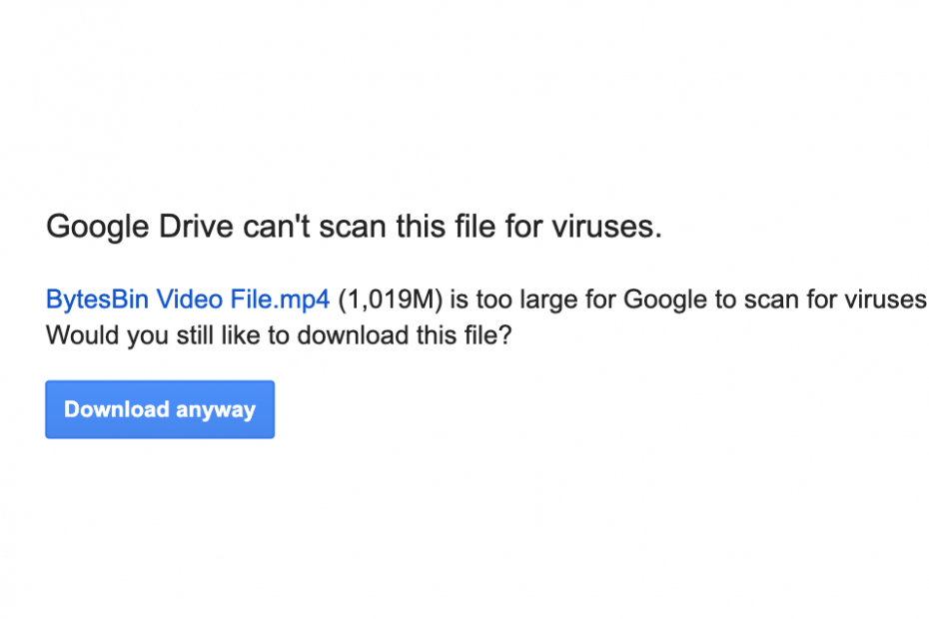
Some services have limitations when scanning files.
They prioritize speed and delivery

Slide 32
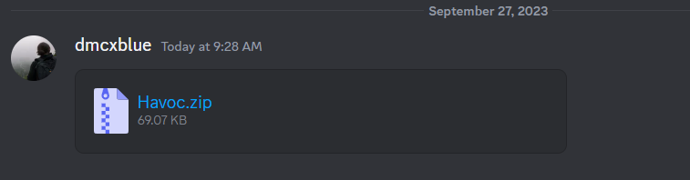
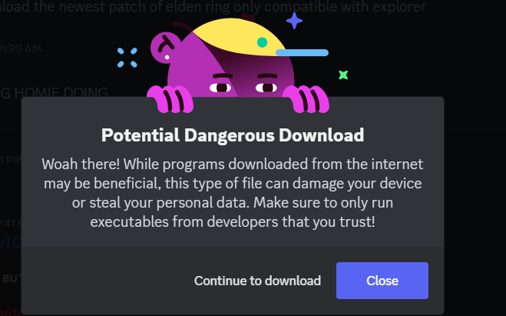
Others allow them
But of course, they come with Warnings

Slide 33
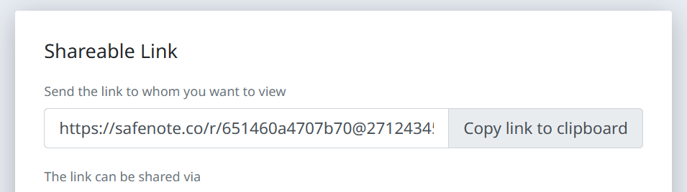
Some sites don’t bother looking at the files

Slide 34
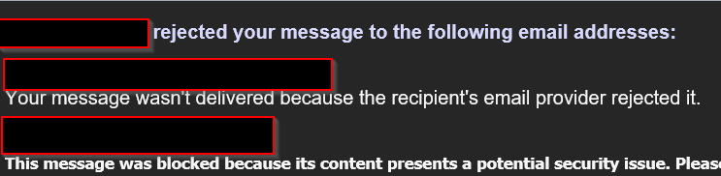
HTML Smuggle
File smuggling is a technique that allows bypassing proxy blocks for certain file types that the user is trying to download. For example, if a corporate proxy blocks .exe files from being downloaded via the browser, this is the technique you can use to smuggle those files through.
https://outflank.nl/blog/2018/08/14/html-smuggling-explained/

Slide 35
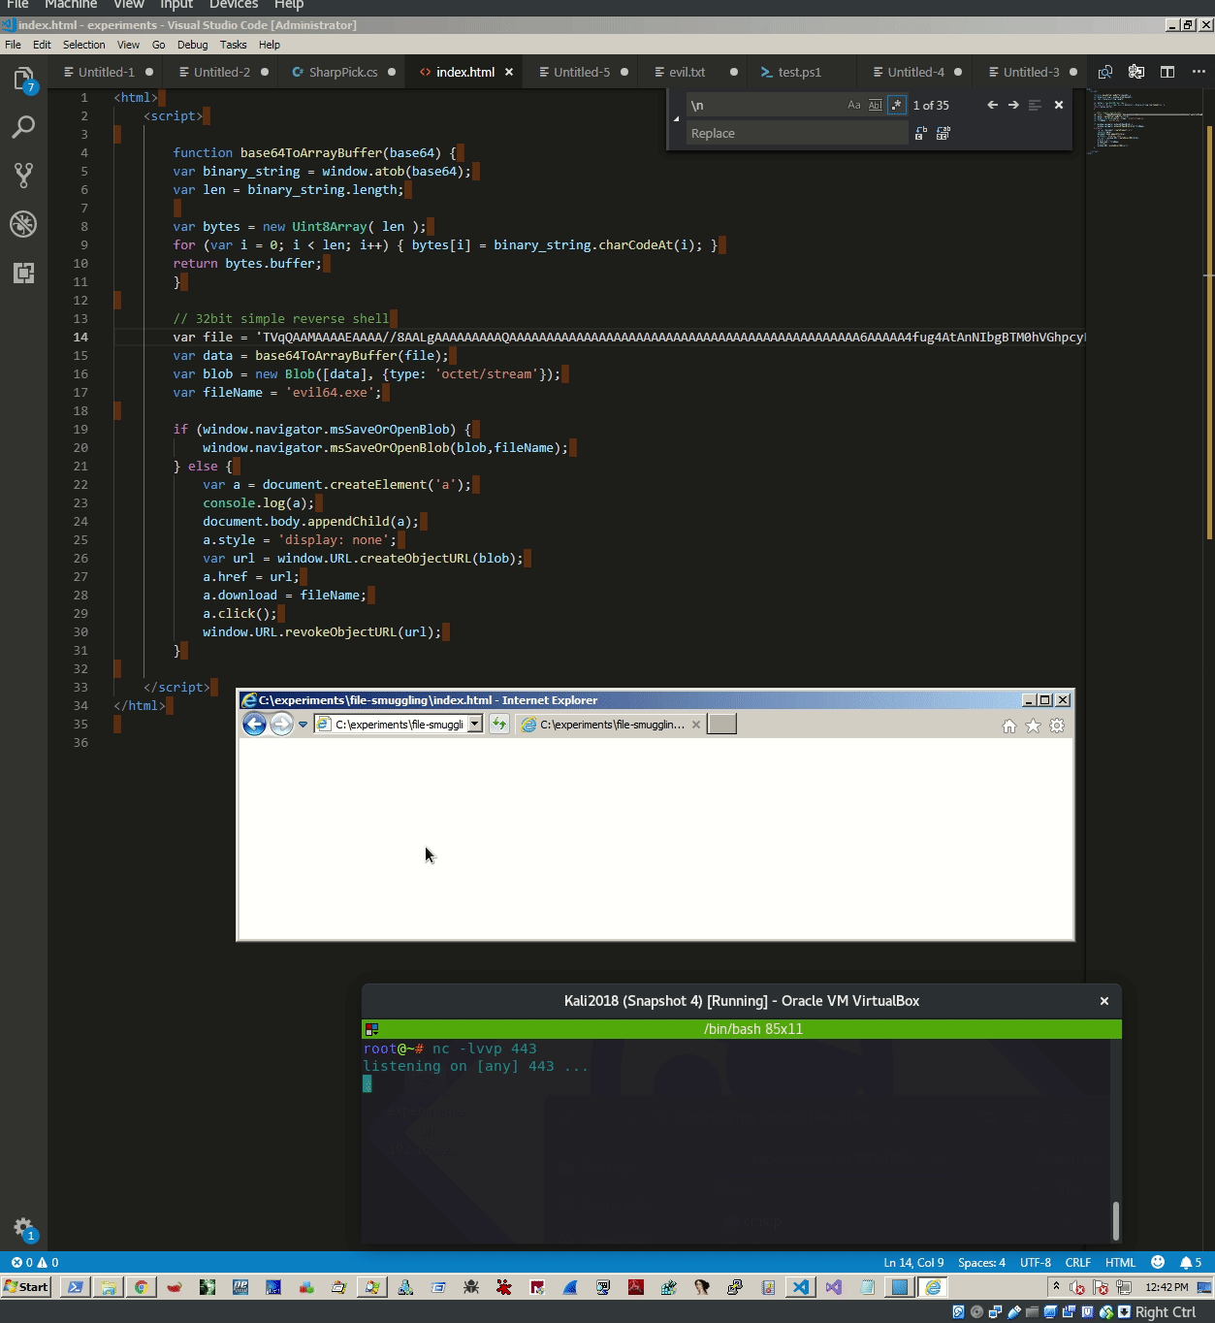

Slide 36
HAVOC

Slide 37
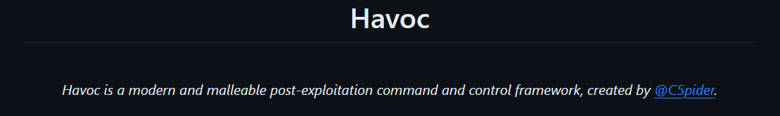
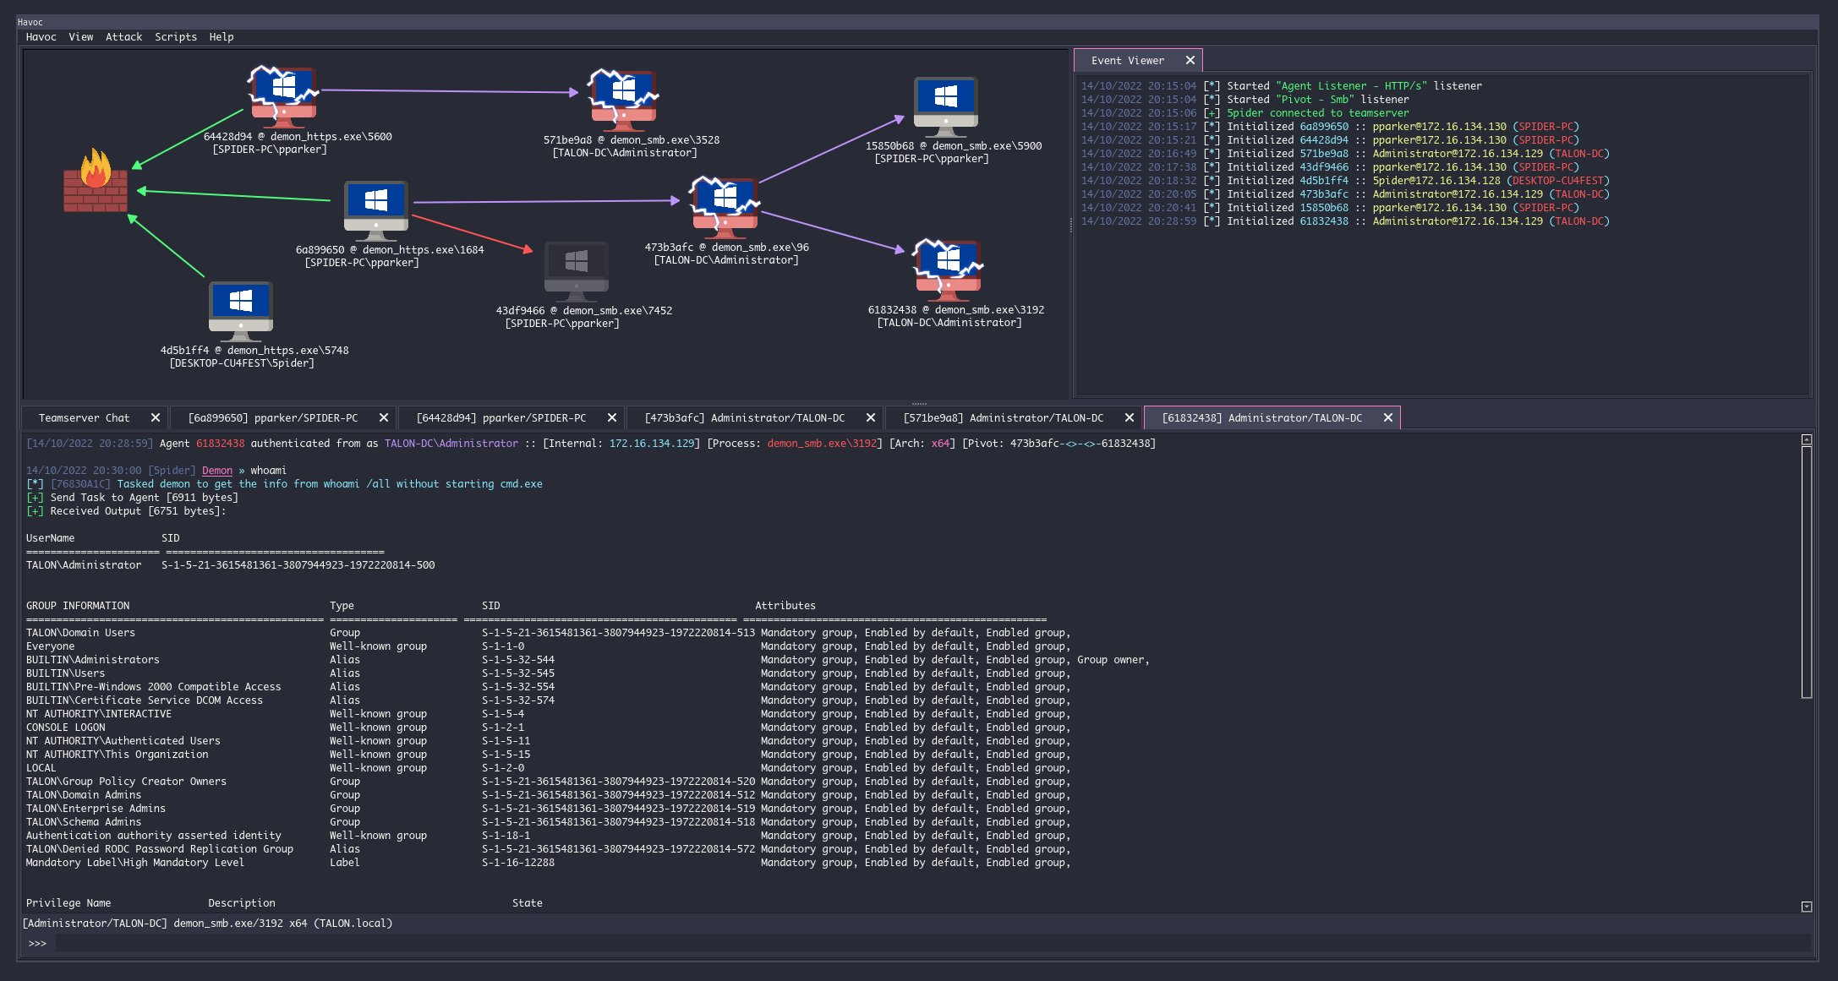

Slide 38

Installation

Slide 39
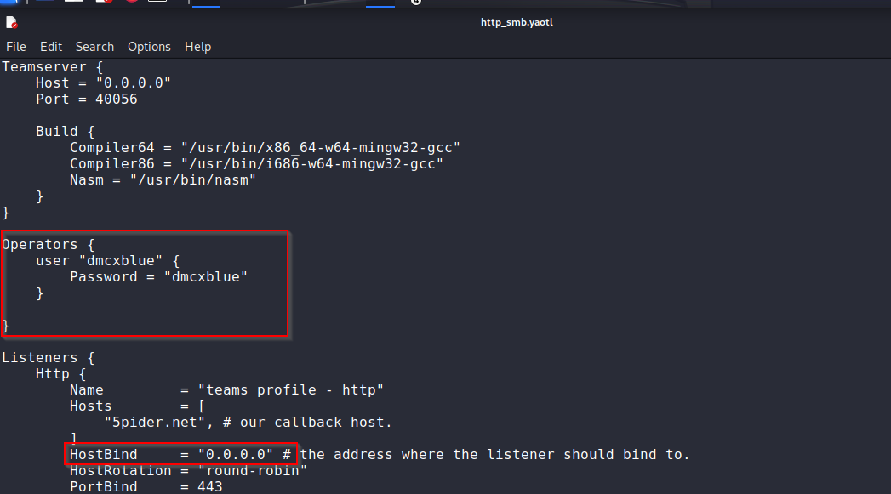
C2 Profile:
A C2 profile is what the C2 will utilize to “pretend” and blend in with network traffic, to look like a legitimate HTTP/HTTPS traffic instead of a malicious one, where commands are being sent

Slide 40
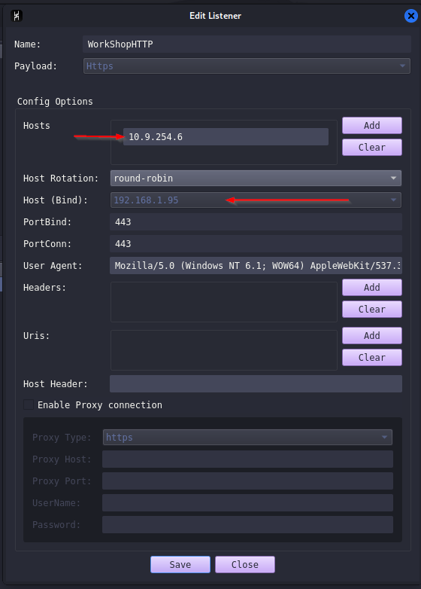
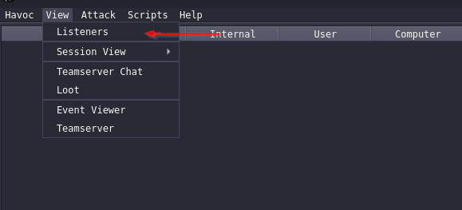
Listeners
Please make sure your IP is pointing to your LAB IP

Slide 41
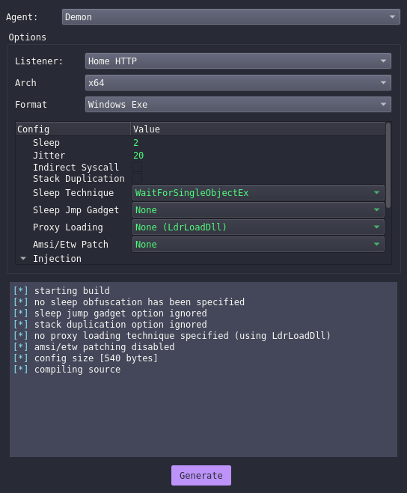
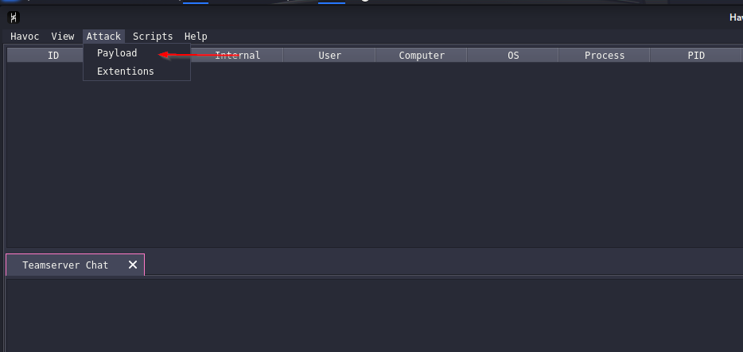
Payload Building

Slide 42
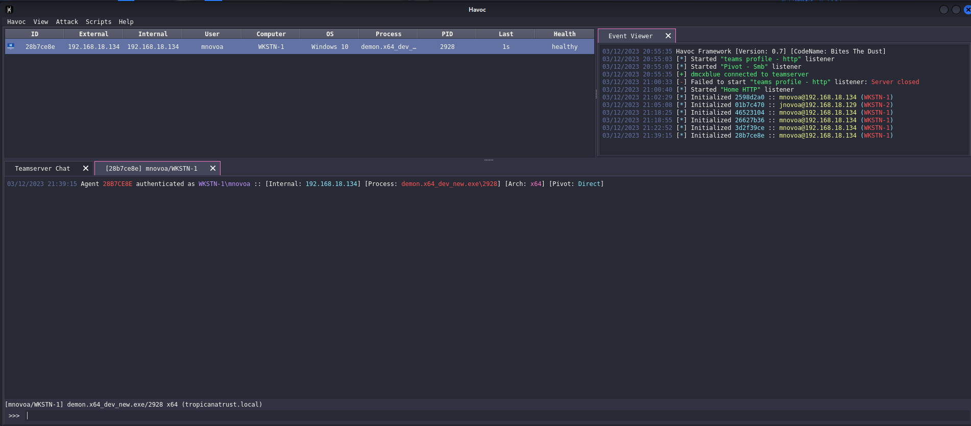
GUI and First Demon

Slide 43
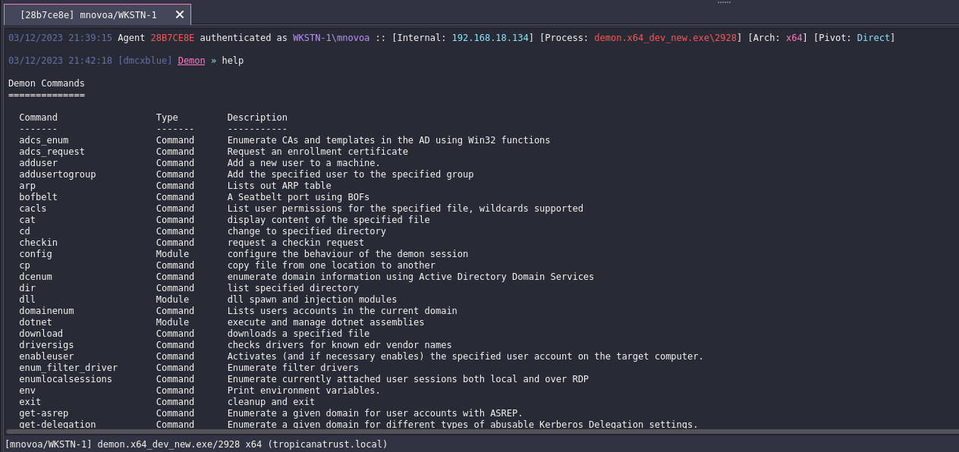

Slide 44
DEMO

Slide 45
Internal Enumeration

Slide 46
PowerView
PowerView is a PowerShell tool to gain network situational awareness on Windows domains. It contains a set of pure-PowerShell replacements for various windows "net *" commands, which utilize PowerShell AD hooks and underlying Win32 API functions to perform useful Windows domain functionality.
https://powersploit.readthedocs.io/en/latest/Recon/

Slide 47
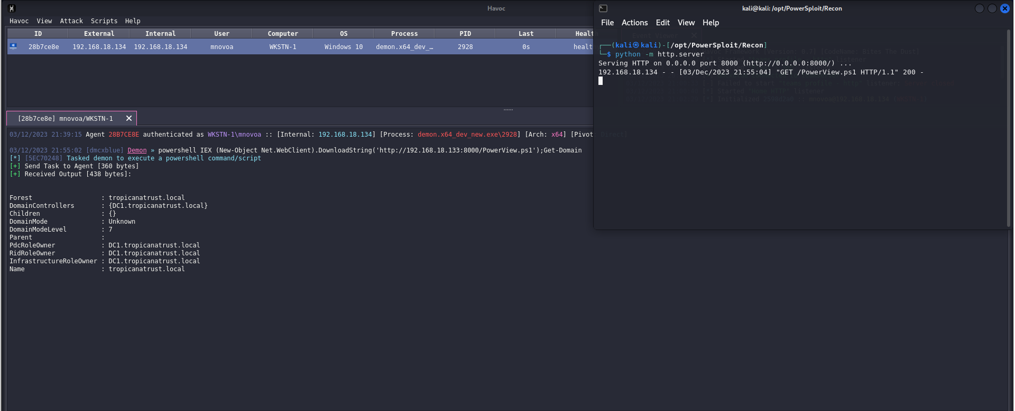
Domain Enumeration

Slide 48
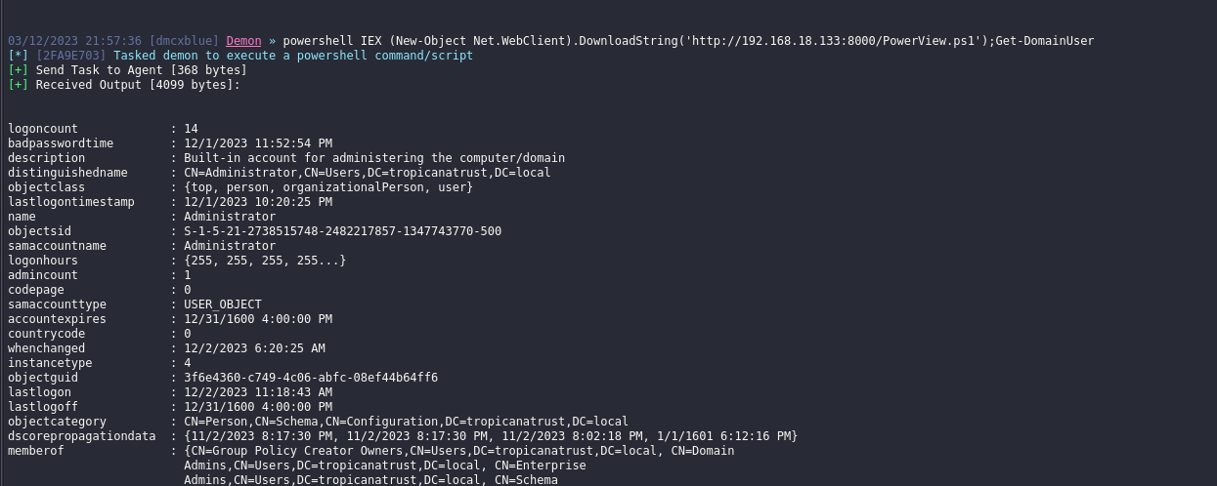
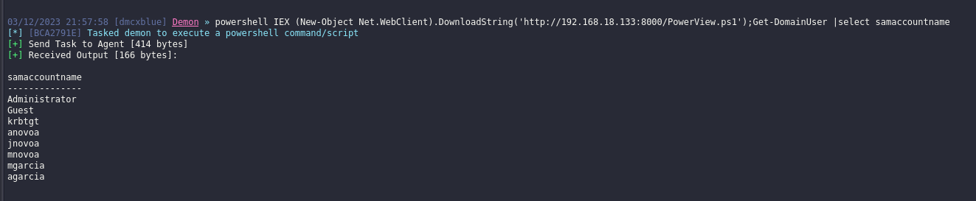
Domain User

Slide 49
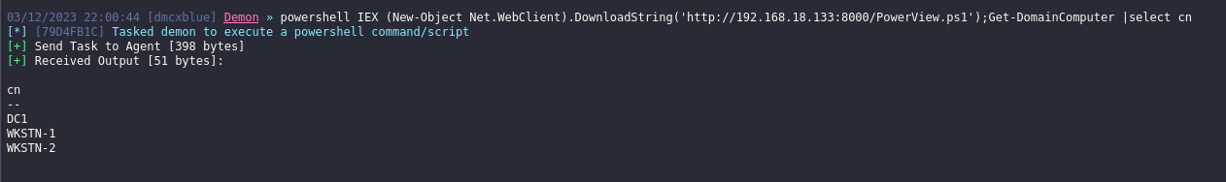
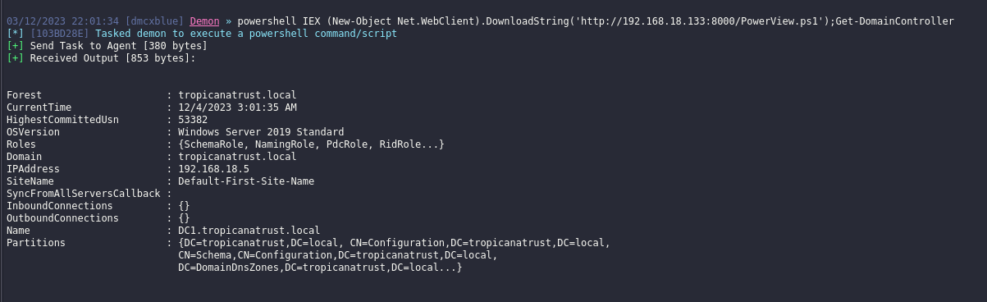

Slide 50
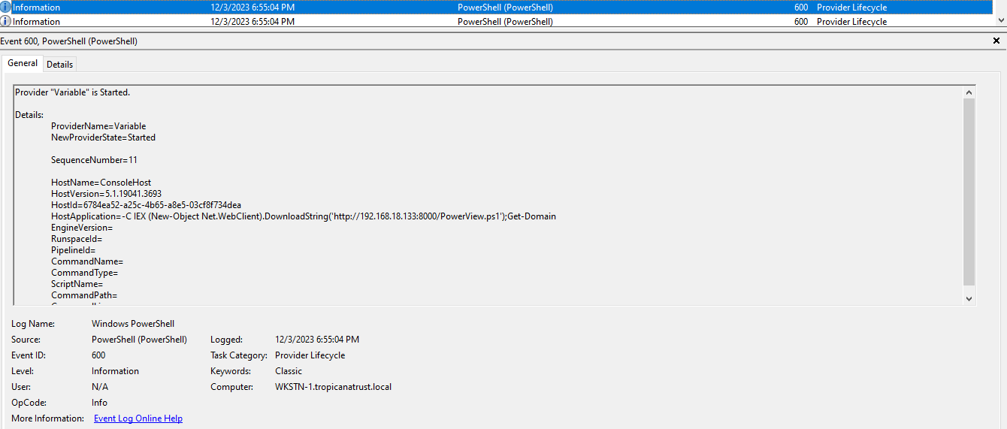

Slide 51
SharpView
SharpView is a .NET Port of PowerView, its functionality is the same but with .NET we have the capability of loading binaries in memory used by C2s, Example: Execute-Assembly, dotnet inline-execution, etc.
As in memory techniques got quite popular and PowerShell started becoming better at Detections and Logging, operators had to move to a different method for executing their PowerShell enumeration tools, you might find a ton of PowerShell tools ported to C# because of this.

Slide 52
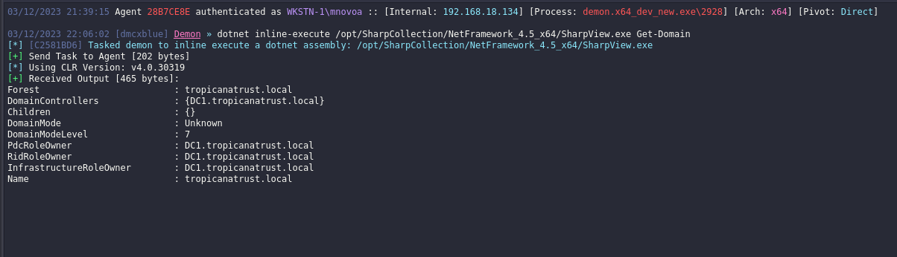
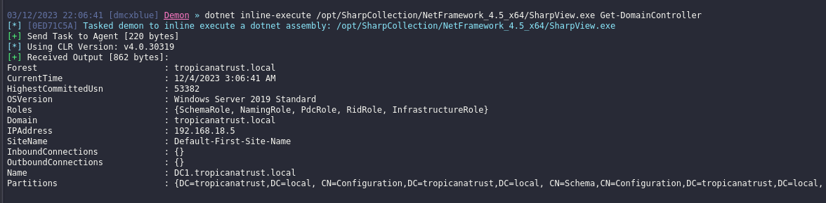

Slide 53
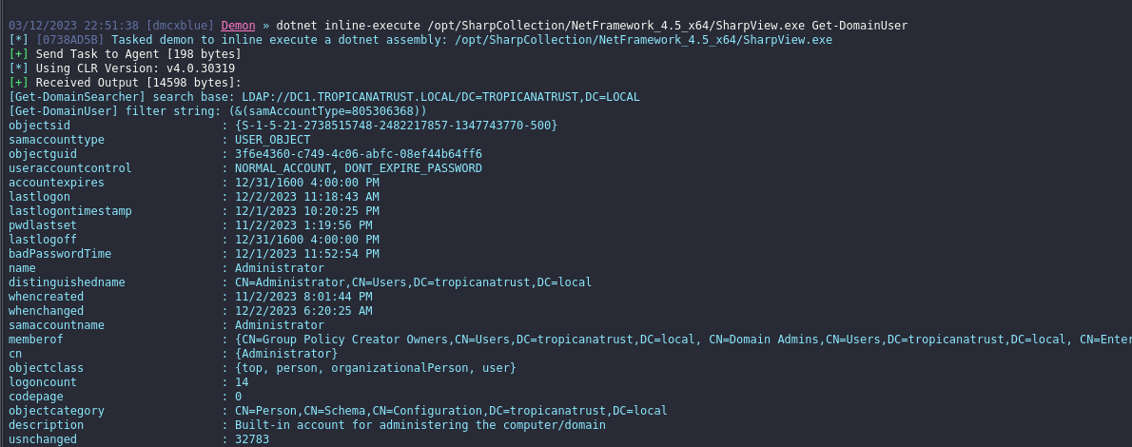
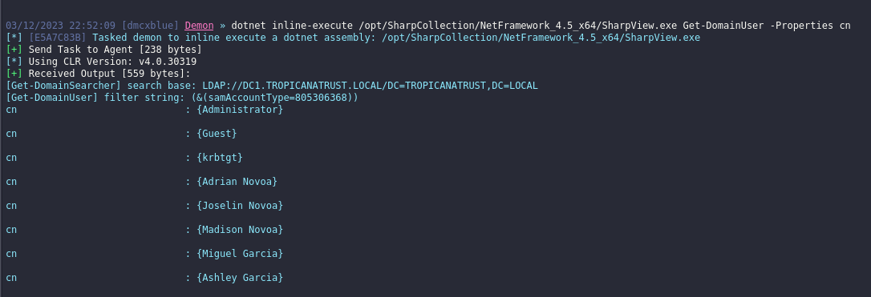

Slide 54
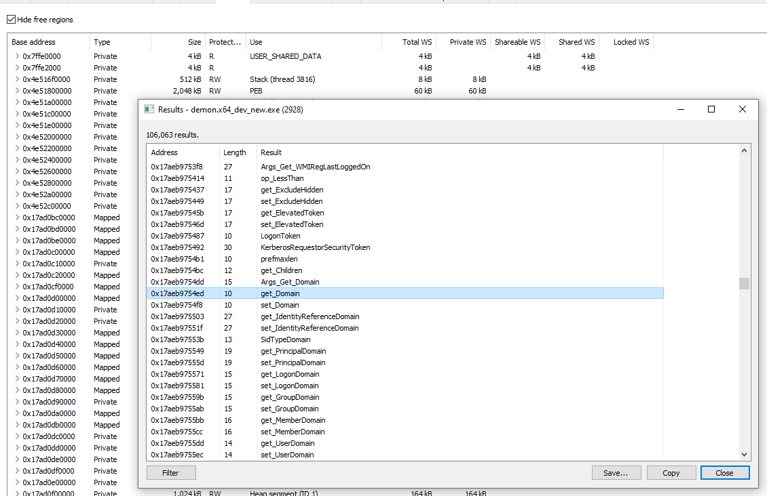

Slide 55
BloodHound
BloodHound uses graph theory to reveal the hidden and often unintended relationships within an Active Directory or Azure environment. Attackers can use BloodHound to easily identify highly complex attack paths that would otherwise be impossible to quickly identify
https://github.com/BloodHoundAD/BloodHound

Slide 56
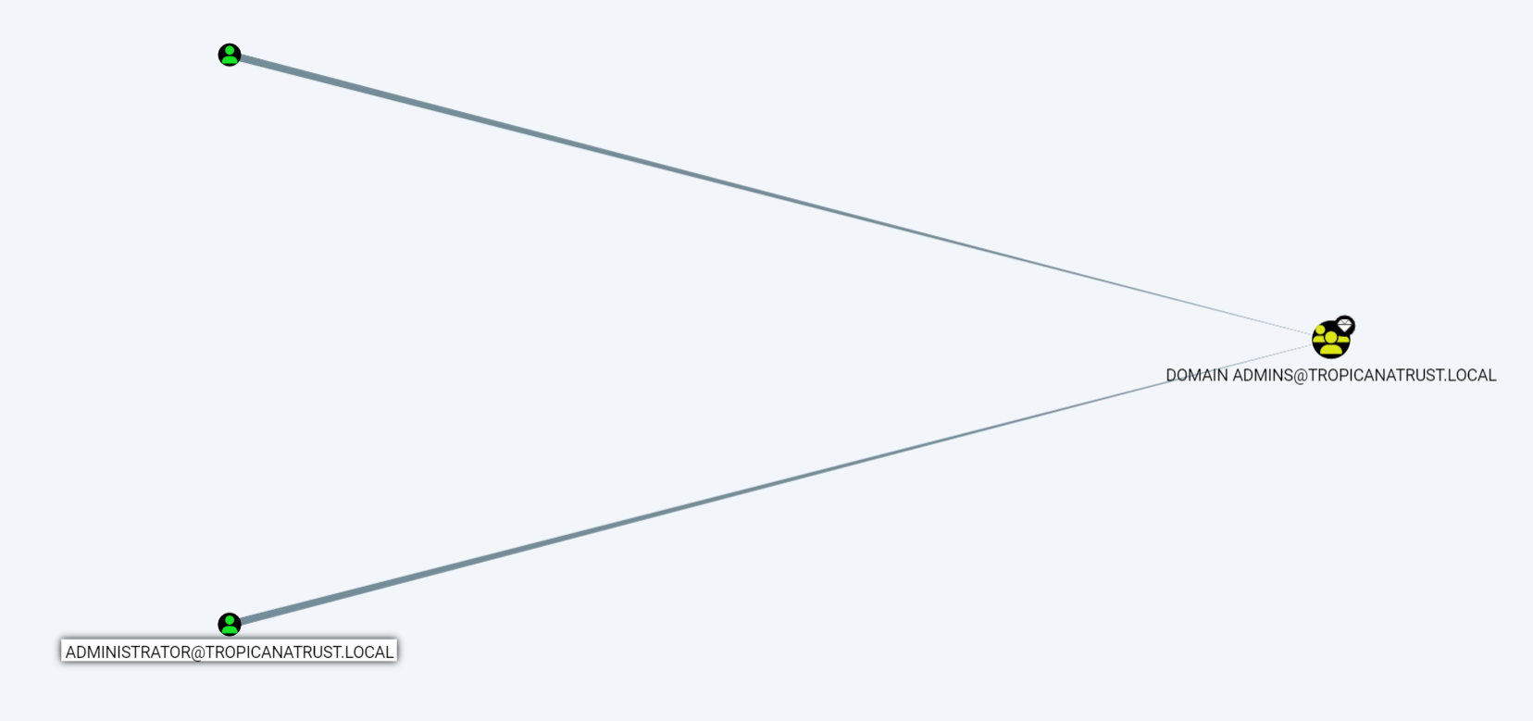

Slide 57
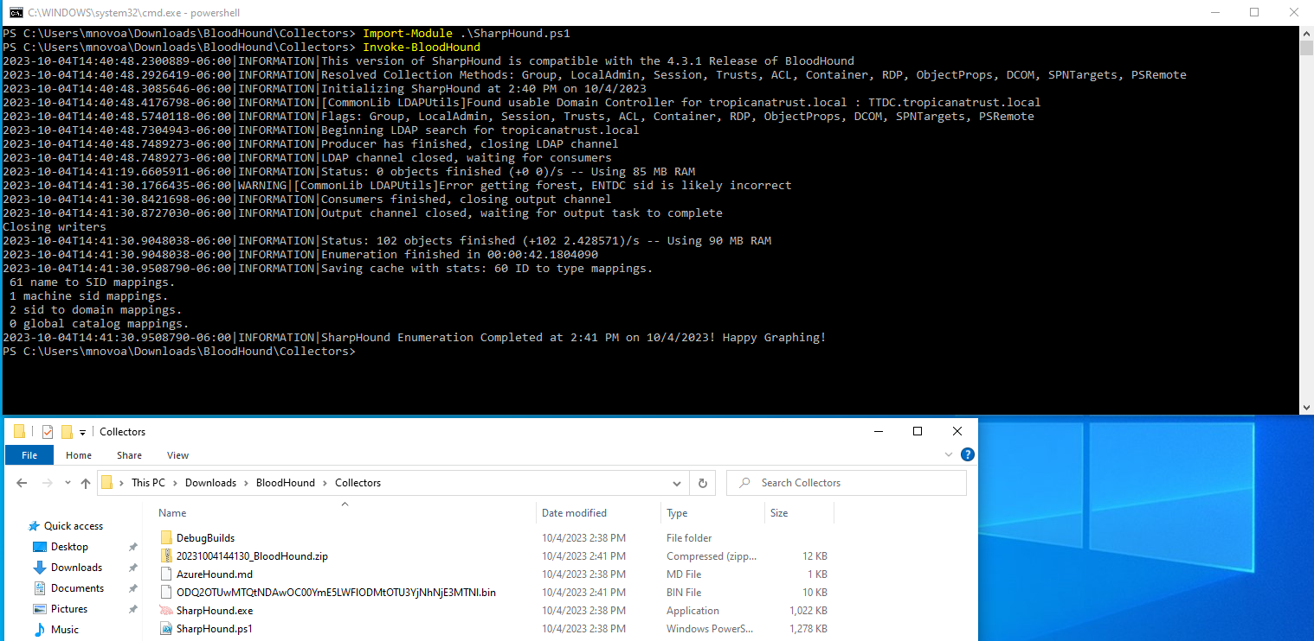

Slide 58
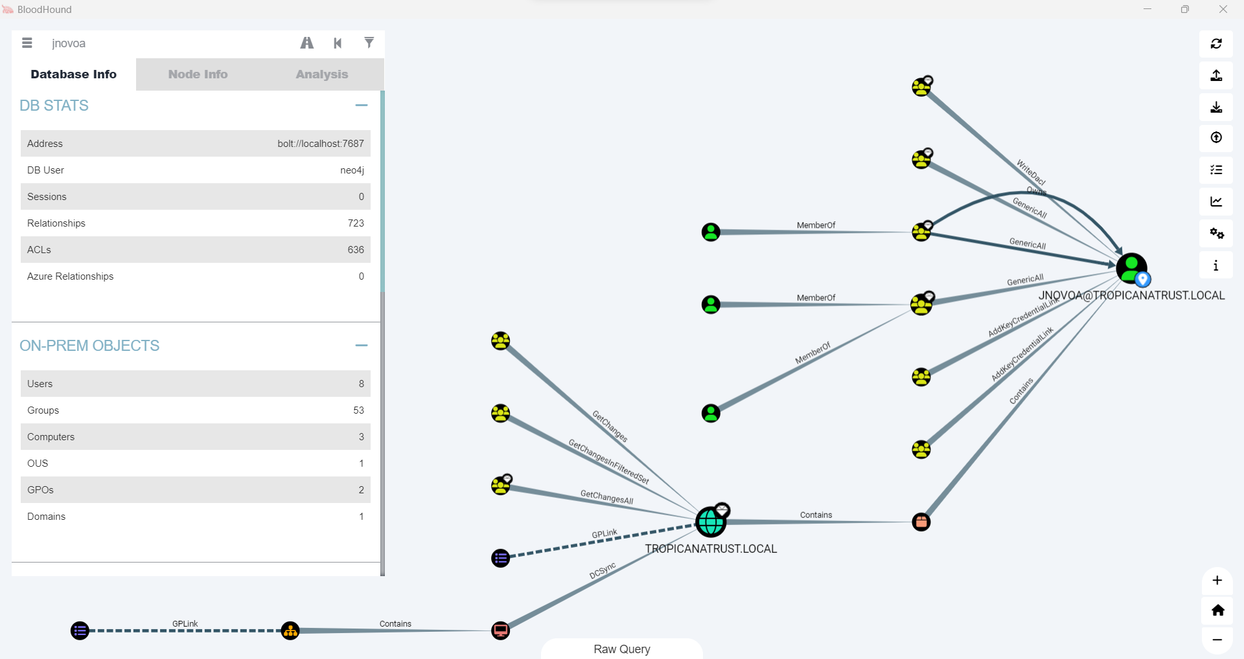

Slide 59
Exercise

Slide 60
Persistence (User Level)
Persistence consists of techniques that adversaries use to keep access to systems across restarts, changed credentials, and other interruptions that could cut off their access.
These methods are only achievable by user level permissions the operator wouldn't have access to anything that requires administrator privilege.

Slide 61
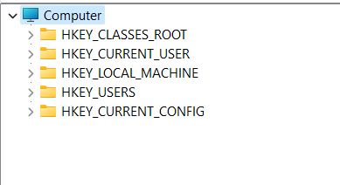
Registry Keys
There are 2 categories of registry key the SYSTEM and USER keys the user has access to edit the user keys and modify as they user would like to but some that are to be mentioned are the Run and RunOnce keys, they are helpful since they would run when a user logs out or restarts the machine.

Slide 62
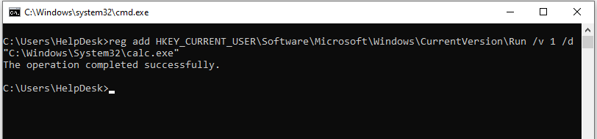
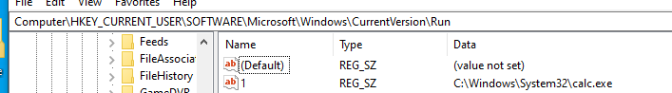
OPSEC: This key will not remove itself once executing!!!

Slide 63


Opsec: This will remove on its own once executed

Slide 64
Start Up Folder
The startup up folder is a folder that contains programs that will initiate at boot time once a user has logged onto their session, this is another great method for user persistence as the user has write permissions in their own start up folder.
Anything placed in these folder will execute once a user logs in.

Slide 65

There are 2 locations for startups, the current user folder and the common folder, the current user
will show you the location of the current working users startup folder. The common folder will show you the location
of the applications that will be ran when ANY user logs in.
shell:staruup
shell:common startup

Slide 66



Slide 67
Exercise
Test your Persistence Techniques:
Look for any OPSEC considerations such as removing your file or maybe leaving a command instead of a binary??
Try as many as you like maybe other persistence techniques from here:
https://github.com/swisskyrepo/PayloadsAllTheThings/blob/master/Methodology%20and%20Resources/Windows%20-%20Persistence.md

Slide 68
Privilege Escalation
The Operator is trying to escalate their privileges on the Network.
Achieving high level privileges is not completely necessary to achieve goals in a Red Team but it is
helpful, we probably need To:
Files, Folder, Locations
Applications
Run tools with high privileges, such as Rubeus to capture tickets and inject
Leave persistence in locations with high permissions (Services, Registry Keys)
Access Credentials (lsass, Browser, Vault)

Slide 69

Unquoted Service Paths
A very popular and well-known technique usually some software have very minor but important configurations missing
for example, Quoting (“ ”) a full path of a file or binary, we are aware that Windows has some folders that contain
spaces in them (C:\Program Files\) and these folders or paths without a quote windows sees them as an End Line
where that is a termination of a file name, here is the reason why it's necessary to quote the path so windows sees it as a
complete path when a space(" ") is in the path name.

Slide 70

SharpUp
Invoke-PrivescCheck

Slide 71


Slide 72



Slide 73
Weak Service Permissions
Modifiable Service
Adversaries may use flaws in the permissions of Windows services to replace the binary that is executed upon service start.
If the permissions on the file system directory containing a target binary, or permissions on the binary itself are improperly set, then the target binary may be overwritten with another binary using user-level permissions and executed by the original process.
Tools like: Invoke-PrivescCheck and SharpUp can help locate these weak permissions.

Slide 74



Slide 75
Credential Access
The adversary is trying to steal account names and passwords. Techniques used to get credentials include keylogging or credential dumping.
Using legitimate credentials can give adversaries access to systems, make them harder to detect, and provide the opportunity to create more accounts to help achieve their goals.

Slide 76

Credentials from Password Stores: Credentials from Web Browsers
Adversaries may acquire credentials from web browsers by reading files specific to the target browser.
Web browsers commonly save credentials such as website usernames and passwords so that they do not need to be entered manually in the future. Web browsers typically store the credentials in an encrypted format within a credential store; however, methods exist to extract plaintext credentials from web browsers.
Adversaries have executed similar procedures for common web browsers such as FireFox, Safari, Edge, etc. This is usually protedted by DPAPI which uses the user's logon credentials as a basis for creating encryption keys. This means that data encrypted with DPAPI on one user account cannot be decrypted using the credentials of another user.

Slide 77


Keys are encrypted with the user's encryption leys that’s why Administrator Access is not needed
(DPAPI)

Slide 78

LSASS
LSASS is primarily tasked with authenticating users during the login process. It validates user credentials, such as usernames and passwords, ensuring that only authorized users gain access to the system.

Slide 79


OPSEC: Signature is Broken to avoid AV Detection, mimikatz or pypykatz won’t work if you do not restore

Slide 80


You can simply create a dump within Task Manager

Slide 81


Slide 82


Slide 83
Scheduled Tasks
Scheduled Tasks are meant to run tasks at a set number of intervals that any user can setup (This can also be persistence) when a different user is setting up a task the credentials of that user need to be specified and with this mimikatz can actually retrieve the Cleartext credential from the task

Slide 84

Only SYSTEM can access these Credentials, not even Administrator can reach it
privilege::debug – For Impersonating A User
Token::elevate – To use a SYSTEM Token
vault::creds /patch – To grab credentials from a
Vault which hold the Task Scheduled
Credentials

Slide 85

Hashcat
hashcat is the world's fastest and most advanced password recovery utility, supporting five unique modes of attack for over 300 highly-optimized hashing algorithms. hashcat currently supports CPUs, GPUs, and other hardware accelerators on Linux, Windows, and macOS, and has facilities to help enable distributed password cracking.

Slide 86


Starting and Cracking HASH
hashcat.exe -a 0 -m 0 hash.txt wordlist.txt
-a: Attack Method
-m: Hash Type
Hash File
Dictionary File

Slide 87
Exercise

Slide 88
Lateral Movement
Lateral movement is when our Operator will try to jump from one workstation to another, in this section Situational Awareness plays a big role, the operator will need to locate workstations/servers that can help in reaching our goal
OPSEC: Consider understanding the environment, if the network uses certain applications or services to move around. No need for complicated exploits and techniques if we can just blend in with what they are working with (Citrix, TeamViewer, VNC, etc)

Slide 89
Finding Local Admin Access
We need to find WHERE we can execute commands, workstations, servers, printers. What locations can we reach with our new credentials.
SharpView – Find-LocalAdminAccess
PowerShell – Find-PSRemotingLocalAdminAccess
PowerShell – Invoke-Command –ComputerName NAME – ScriptBlock {COMMAND}
Dir – Listing the C$ Directory means we are Administrator on the host (sort of)

Slide 90


Tokens
Havoc has a module named “token” with this you can create a token for a user you have credentials for and use it in your current session.
This allows us to list directories but how to we move here??

Slide 91

Find-PSRemotingLocalAdminAccess
This will create a list of Workstations available in a domain and utilize the Invoke-Command method to execute a command on the computer list, if successful it will point out what workstation

Slide 92
PSEXEC
PsExec is a command-line utility provided by Microsoft Sysinternals that allows you to execute processes on remote systems. It is particularly useful for system administrators and IT professionals for tasks such as remote administration, troubleshooting, and running commands or programs on multiple machines.
HAVOC has a built-in support for PSEXEC
Example:
psexec \\RemoteComputer -u Username -p Password cmd.exe

Slide 93
Havoc will connect to the remote host, create a Service and add the BIN Path to the bin we tell it to utilize, will be able to connect to the remote machine by utilizing the pivot command:
To complete the process will use the jump-exec command from Havoc will give it the method, remote workstation and the path where our SERVICE Binary is located.
Finally, we can connect to it by using the pivot command with the remote workstation and pipe name as parameters

Slide 94


Building an SMB Listener
Available Lateral Movement modules

Slide 95


Slide 96

OPSEC: Consider to blend into the Environments naming conventions

Slide 97

OPSEC: Take a look at the binary path, suspicious running a file remotely, depending on the environment,
It’s recommended to leave a file on HOST to avoid this

Slide 98



Slide 99



Slide 100
Q&A

